Slide 1
E – retail factors for customer activation and retention:
A case study from Indian E – commerce customers.

Slide 2

Contents
Problem Statement & Objective 3 – 5
Literature Review 6
Exploratory Data Analysis 6 – 12
Conclusion 11

Slide 3
INTRODUCTION
With the rapid global growth in electronic commerce (e-commerce), businesses are attempting to gain a competitive advantage by using e-commerce to interact with customers.
Nowadays, online shopping is a fast-growing phenomenon. Growing numbers of consumers shop online to purchase goods and services, gather product information or even browse for enjoyment. Online shopping environments are therefore playing an increasing role in the overall relationship between marketers and their consumers.
In this presentation we will be looking at the analysis made on the customer retention rate for Indian e-commerce companies.
We will be analysing the customers retention rate and e-commerce success rate with the help of a survey answered by the customers on online retail companies and the factors that influence their purchase decision.
This analysis includes the expectations, reliability, trustworthiness etc of the customers on a good e-tailer store.

Slide 4
Problem Statement & Objective
Q: What is Customer Retention?
Customer Retention refers to a company’s ability to turn customers into repeat buyers and prevent them from switching to a competitor. It indicates whether your product and the quality of the service please your existing customers. Customer Retention strategies are the processes and initiatives businesses put in place to build customer loyalty and improve customer lifetime value.
Q: Why is it important?
Customer retention increases your customers’ lifetime value and boosts your revenue. It also helps you build amazing relationship with your customers. You aren’t just another website or store. They trust you with their money because you give them value in exchange. According to the Harvard Business Review, acquiring a new customer can be 5 to 25 times more expensive than holding on to an existing one. You don’t need to spend big on marketing, advertising or sales outreach. It is easier to turn existing customers into repeating ones, since they already trust your brand from previous purchases. New customers, however, often require more convincing when it comes to the initial sale.

Slide 5
Problem Statement & Objective
Q: What are its benefits?
Retention is Cheaper than Acquisition
Loyal Customers are more profitable.
Your Brand will stand out from the crowd.
Engage customers provide more feedback.
Loyal customers are more forgiving.
Customers will explore your brand
Customer Retention refers to the action and strategies a business uses to try and keep existing customers. To enable these actions, customer retention analytics provide predictive metrics of which customer might churn-which enable them to get ahead of it. Customer satisfaction and customer loyalty. A comprehensive review of the literature, theories and models have been carried out to propose the models for customer activation and customer retention. Five major factors that contributed to the success of an e-commerce store have been identified as: service quality, Customer satisfaction has emerged as one of the most important factors that guarantee the success of online store; it has been posited as a key stimulant of purchase, repurchase intentions system quality, information quality, trust and net benefit. The research furthermore investigated the factors that influence the online customers repeat purchase intention. The combination of both utilitarian value and hedonistic values are needed to affect the repeat purchase intention (loyalty) positively. The data is collected from the Indian online shoppers. Results indicate the e-retail success factors, which are very much critical for customer satisfaction. Analytical skills has been applied to give findings and conclusion in detail.

Slide 6
Literature Review
Customer satisfaction has emerged as one of the most important factors that guarantee the success of online store; it has been posited as a key stimulant of purchase, repurchase intentions and customer loyalty. A comprehensive review of the literature, theories and models have been carried out to propose the models for customer activation and customer retention. Five major Factors that contributed to the success of an e-commerce store have been identified as service quality, system quality, information quality, trust and net benefit. The research furthermore investigated the factors that influence the online customers repeat purchase intention.
Purchase Intention
User Satisfaction
Net Advantages
Data Quality
Framework Quality

Slide 7
3.Exploratory Data Analysis
There are 269 rows and 71 columns.
There are no missing values in the dataset.
There are unwanted characters in columns.
There are 70 object type variable and one is int64 variable, however it is also categorical in nature.

Slide 8
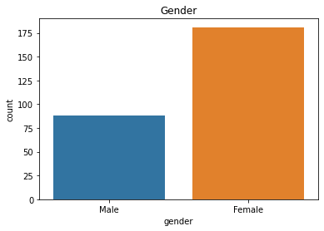
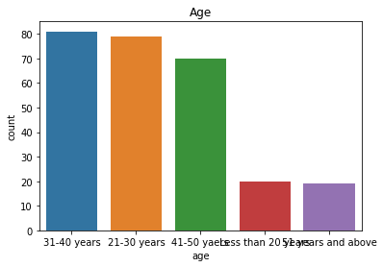
3.Exploratory Data Analysis
The number of gender of respondent for Female customers have high counts compared to Male customers. That is around 67% of female customers shopped online and only 32% of male customers shopped online.
Customers aged between 21-50 yrs mostly doing online shopping

Slide 9
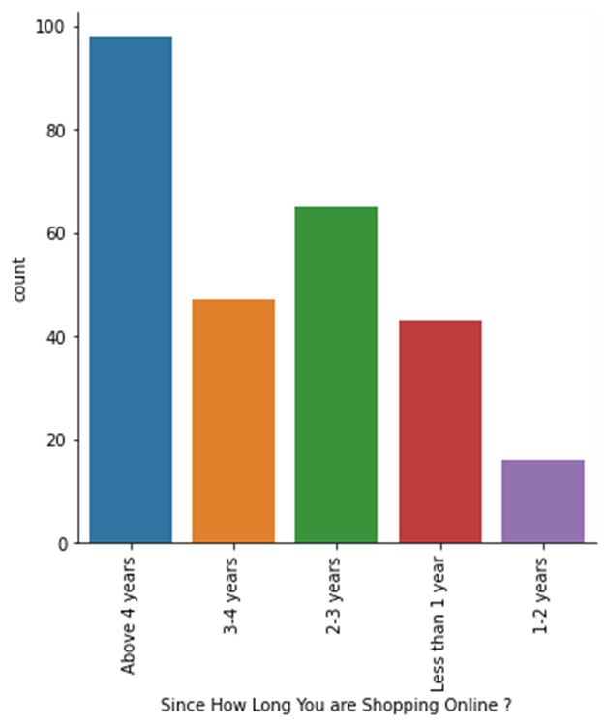
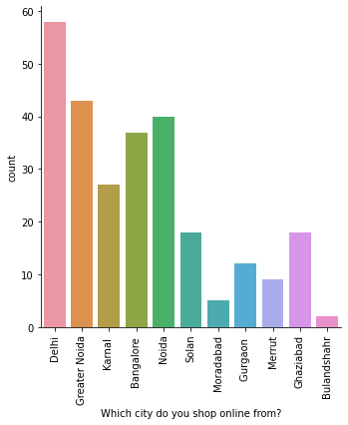
3.Exploratory Data Analysis Contd…
Delhi is the most prone for online shopping followed by Greater Noida and Noida
Moradabad and Bulandshahr has least number of shoppers.
Majority of people are shopping from more than 4 years.

Slide 10
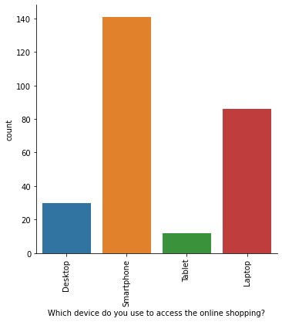
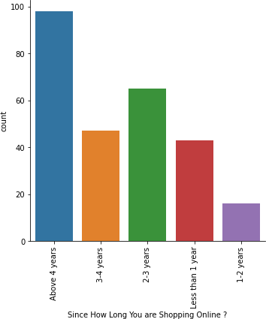
3.Exploratory Data Analysis Contd…
As we observed earlier that majority of population use Mobile internet so here we can see smartphone is the mostly used.
Majority of people are shopping from more than 4 years.

Slide 11
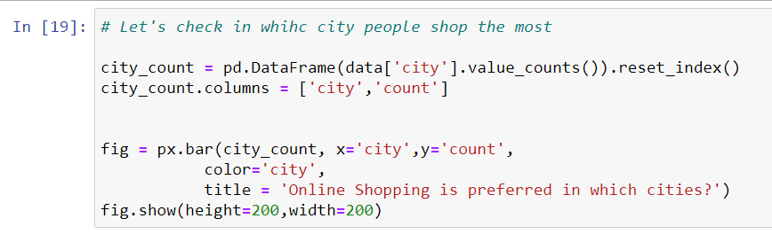
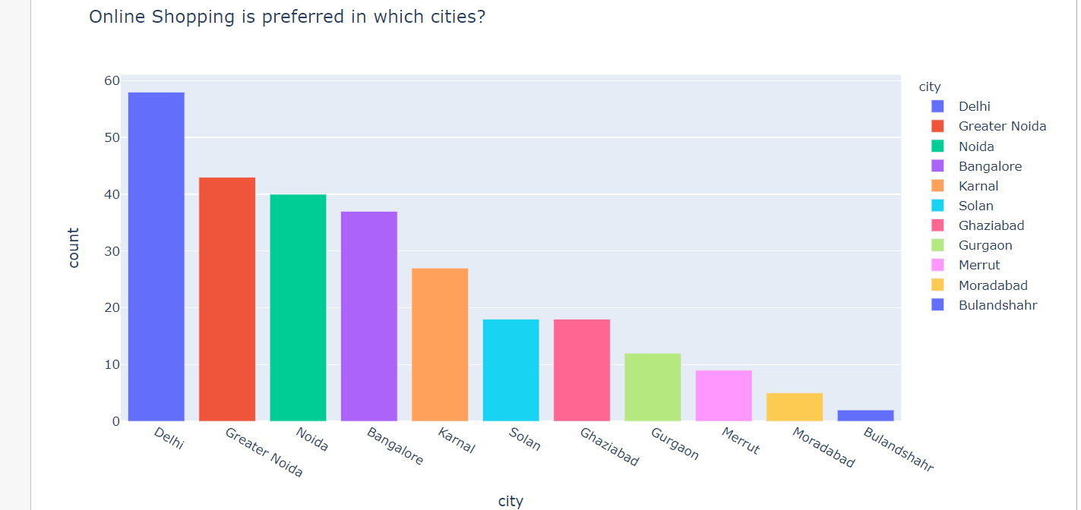
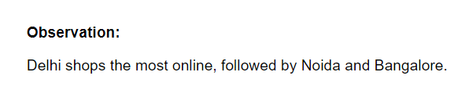

Slide 12
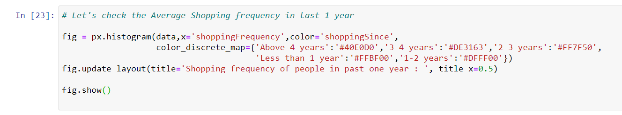
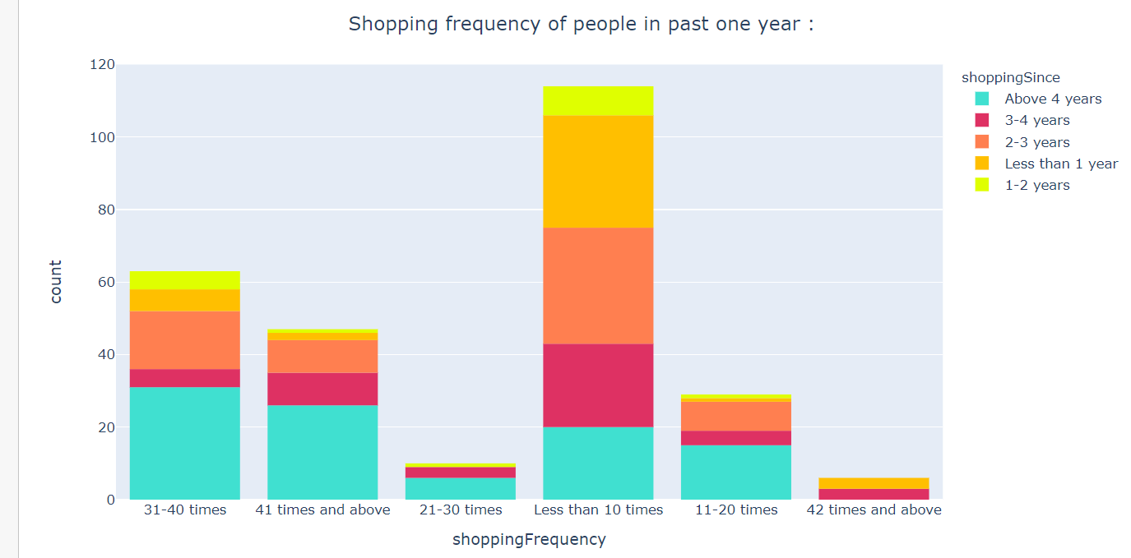
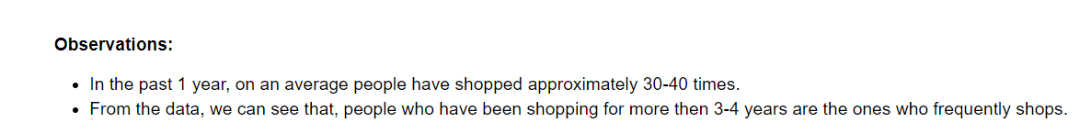

Slide 13
CONCLUSION
When customers are satisfied with a company or service, there is a high possibility that they will share their experience with other people Therefore it is crucial for E-commerce to take into account their customer satisfaction because this will retain customer loyalty as well as attract potential customers.
To conclude, having the right customer retention strategy will keep sellers company growing if they know how to take advantage of it. Then customers will find their way back and continue buying stuff from the best company.

